Slide 1
What Causes the Sprout?
Buddhist Accounts of Cooperative Causation
Itsuki Hayashi
Kyoto University
March 20, 2015
2015 KU-NCCU Graduate Workshop on Asian Philosophy

Slide 2
Background and Thesis
Buddhist proponents of radical impermanence had a peculiar explanation for the occurrence of cooperative production.
In a nutshell, they allude to “collective causal power”
Katsura (2012): Collective power belongs to the conventional totality
Inami (2014): Collective power belongs to the ultimate individual
In a sense, Inami is right. In another sense, Katsura is right.
And I want to add one more observation.
So I want to say that we need a three-level analysis for the Buddhist account.

Slide 3
Contents
Radical Impermanence and the Problem of Cooperative Production
Śāntarakṣita and Kamalaśīla’s Answer: Collective Power
Clarification: Dharmakīrti’s Explanation and Examples
Evaluation of Katsura and Inami

Slide 4
Contents
Radical Impermanence and the Problem of Cooperative Production
Śāntarakṣita and Kamalaśīla’s Answer: Collective Power
Clarification: Dharmakīrti’s Explanation and Examples
Evaluation of Katsura and Inami

Slide 5




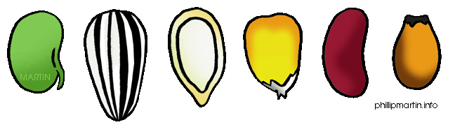

The Problem of Cooperative Production
If every existent is momentary, how can there be cooperative production, e.g. sprout being produced by virtue of a seed being causally influenced by contemporaneous things?
t1 ~ tn tn+1

Slide 6
Contents
Radical Impermanence and the Problem of Cooperative Production
Śāntarakṣita and Kamalaśīla’s Answer: Collective Power
Clarification: Dharmakīrti’s Explanation and Examples
Evaluation of Katsura and Inami

Slide 7
Śāntarakṣita’s Response
“True, there is no mutual assistance [among causal factors] at the initial stage; but they become cooperators by producing a single effect.”
“Even though there is no mutual assistance, [the causal factors] are not undifferentiated; having arisen from their own causes, they are individually but collectively productive.”
Ucyate prathamāvasthā naivānyo’nyopakāriṇaḥ/
Ekārthakriyayā tvete bhavanti sahakāriṇaḥ//
Anyo’nyānupakāre’pi nāviśiṣṭā ime yataḥ/
Svopādānabalodbhū tāḥ kalāpotpādakāḥ pṛthak//

Slide 8
Kamalaśīla’s Commentary
By “individually but collectively productive”, the meaning is that each causal factor individually possesses collective productive power in the second moment.
With respect to the effect in the third moment [namely the sprout], the specialties of the second moment serve by being a cause [taken as a totality].
kalāpotpādakāḥ pṛthagiti/ pratyekaṃ dvitīyakṣaṇabhāvikalāpotpādanasamarthā ityarthaḥ/
Tatra tṛtīyāvasthābhāvini kārye ye dvitīyakṣaṇabhāvino viśeṣā upayujyante kāraṇabhāvena/

Slide 9

The Cause of Sprout
Collective Power
Collective Power
Collective Power
Collective Power
t1 t2 t3

Slide 10
Contents
Radical Impermanence and the Problem of Cooperative Production
Śāntarakṣita and Kamalaśīla’s Answer: Collective Power
Clarification: Dharmakīrti’s Explanation and Examples
Evaluation of Katsura and Inami

Slide 11
Clarificatory Questions
What is “Collective Power”?
Do individual causes have the same, or similar, powers or are they different?
What is the point of allowing the collection to be called a single cause?

Slide 12
Clarificatory Questions
What is “Collective Power”?
Do individual causes have the same, or similar, powers or are they different?
What is the point of allowing the collection to be called a single cause?

Slide 13
Dharmakīrti’s Example
HB9, 13-10, 4
A pot, made by some cooperative causal factors, viz. a lump of clay, a potter, strings, etc., has:
An essential feature distinguishing it from non-clay things such as trees, etc., caused by the lump of clay.
A certain special form distinguishing it from other [clay] things, caused by the potter.
An essential feature distinguishing it from other [jar] things such as a pot made with a potter’s wheel, caused by the strings.
mṛtpiṇdakulālasūtrādibhyo bhavato ghaṭasya mṛtpiṇdād amṛtsvabhāvebhyo vṛkṣādibhyo bhinnaḥ svabhāvaḥ kulālāt tasya eva mṛdātmanaḥ sataḥ saṃsthānaviśeṣātmatayā tadanyebhyo bhinnaḥ sūtrāt tasya eva mṛtsaṃsthānaviśeṣātmanaś cakrāder vibhaktaḥ svabhāvo bhavati

Slide 14
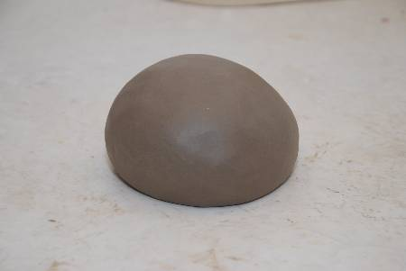
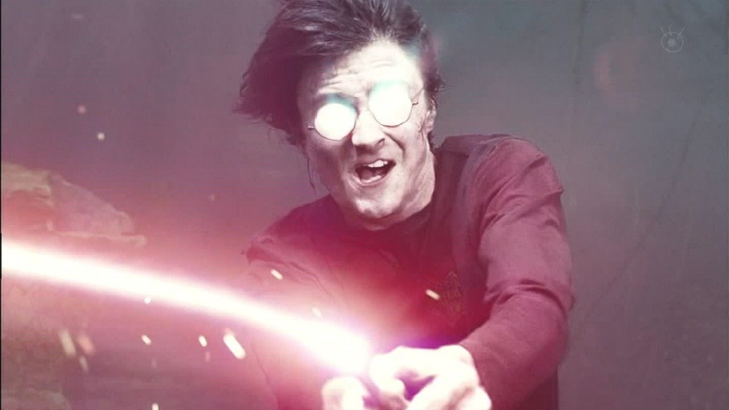


Each cause contributes different characters to the common effect.
Clay-character
Pot-character
Made-with-string-character

Slide 15
Sprout Situation
Each cause contributes different characters to the common effect.
Energy-character
Moisture-character
Plant-character
Mineral-character

Slide 16

Clarificatory Questions
What is “Collective Power”?
Do individual causes have the same, or similar, powers or are they different?
Answer: They have different powers; e.g. producing a single pot.
What is the point of allowing the collection to be called a single
cause?

Slide 17
Dharmakīrti’s Reasons for Counting
Multiple Causes as One Cause
PVSV68, 7-13
When some aggregate of things produce a single effect, a worldly person, who thinks that there is no use to address the differences among them because they have a joint purpose, uses a single word “pot” with respect to them.
PVSV68, 13-18
Moreover, the single word [“pot”] is used for the purpose of indicating the power to produce one thing, or because it depends on verbal convention.
ye samastāḥ kiṃcid ekaṃ kāryaṃ kurvanti teṣāṃ tatra viśeṣābhāvād apārthikā viśeṣacodaneti sakṛt sarveṣāṃ niyojanārtham ekam ayaṃ lokaḥ śabdaṃ teṣu niyuṅkte ghaṭa iti/
ekavacanam api tadekaśaktisūcanārthaṃ saṃketaparatantraṃ vā/

Slide 18
Clarificatory Questions
What is “Collective Power”?
Do individual causes have the same, or similar, powers or are they different?
Answer: They have different powers; e.g. producing a single pot.
What is the point of allowing the collection to be called a single
cause?
Answer: It is more convenient to do so, and/or we have singular
collection words; e.g. an aggregate as a pot.

Slide 19
Clarificatory Questions
What is “Collective Power”?
Do individual causes have the same, or similar, powers or are they different?
Answer: They have different powers; e.g. producing a single pot.
What is the point of allowing the collection to be called a single
cause?
Answer: It is more convenient to do so, and/or we have singular
collection words; e.g. an aggregate as a pot.

Slide 20
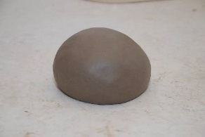



So Ultimately…
NOT BUT
Clay-character
Clay-character
Clay-like thing
Pot-like thing
Made-with-string-like thing
Pot-character
Pot-character
Made-with-string-character
Made-with-string-character

Slide 21
In the Case of Sprout
NOT BUT
Energy-character
Energy-character
Moisture-character
Energetic thing
Moist thing
Plant thing
Mineral thing
Moisture-character
Plant-character
Plant-character
Mineral-character
Mineral-character

Slide 22
What we have so far
Energy Character
Energetic thing
Moist thing
Plant thing
Mineral thing
Moist Character
Plant Character
Mineral Character

Slide 23
Contents
Radical Impermanence and the Problem of Cooperative Production
Śāntarakṣita and Kamalaśīla’s Answer: Collective Power
Clarification: Dharmakīrti’s Explanation and Examples
Dharmakīrti’s explanation, and examples
Evaluation of Katsura and Inami

Slide 24
Recap of the points
Katsura (2012): Collective power belongs to the conventional totality
Inami (2014): Collective power belongs to the ultimate individual

Slide 25

Katsura (2012): Collective power belongs to the conventional totality
Katsura is right in that…
The totality can be regarded as the single cause of the sprout.
But wrong in that…
Collective power belongs to each constituent of the collection.

Slide 26
Inami (2014): Collective power belongs to the ultimate individual
Inami is right in that…
Collective power belongs to each constituent of the totality.
But wrong in that…
The totality can be regarded as the single cause of the sprout.
Energy Character
Energetic
Moist
Plant
Mineral
Moist Character
Plant Character
Mineral Character

Slide 27
One More Point
Katsura is talking about conventional totality (viz. seed, water, etc., taken as a single thing) producing a conventional totality (i.e. sprout).
Inami is talking about ultimate individuals (viz. seed, water, etc., taken individually) producing a conventional totality (i.e. sprout).
Since the effect is really an aggregate of individual effects (corresponding to the individual causes), the fact of the matter really is just this: individual causes produce individual effects.
There is really no such thing as cooperative production.

Slide 28
The fact of the matter really is just this:
Individual causes produce individual effects.
There is really no such thing as cooperative production.
Energy Character
Energetic thing
Moist thing
Plant thing
Mineral thing
Moist Character
Plant Character
Mineral Character

Slide 29
Three Levels of Analysis
Level 3 Collection causes the sprout
Katsura (Conventional – Conventional)
Level 2 Each factor causes the sprout
Inami (Ultimate – Conventional)
Level 1 Each factor causes each effect
Me (Ultimate – Ultimate)

Slide 30
Conclusion
Cooperative production is compatible with momentariness, in the sense of “production of a single effect”.
On one level, collective productive power is possessed by each causal factor independently and without any causal interaction with other co-factors.
On another level, the causal factors can be taken singly as “the” cause of the sprout.
So conventionally, we can say both that each individual cause has a collective power to produce a single effect, and the causal factors taken as a single cause produces a single effect.
But the “single effect” is itself single only in a conventional sense; ultimately it is itself a collection.
Therefore, ultimately speaking, each individual cause produces its own effect, end of story.

Slide 31
Conclusion
Q: What Causes the Sprout?
A: The collection can be said to cause the sprout, by having each constituent produce each property of the sprout (although ultimately there are no sprouts, nor cooperative production as such).

Slide 32
Questions for Further Study
How are we to understand “dependent origination” (pratītyasamutpāda) under radical impermanence metaphysic?
What is the relation between the conventional power attributed to the collection and the powers of the individuals?
What would the analysis look like if we consider consciousness?

